Slide 1
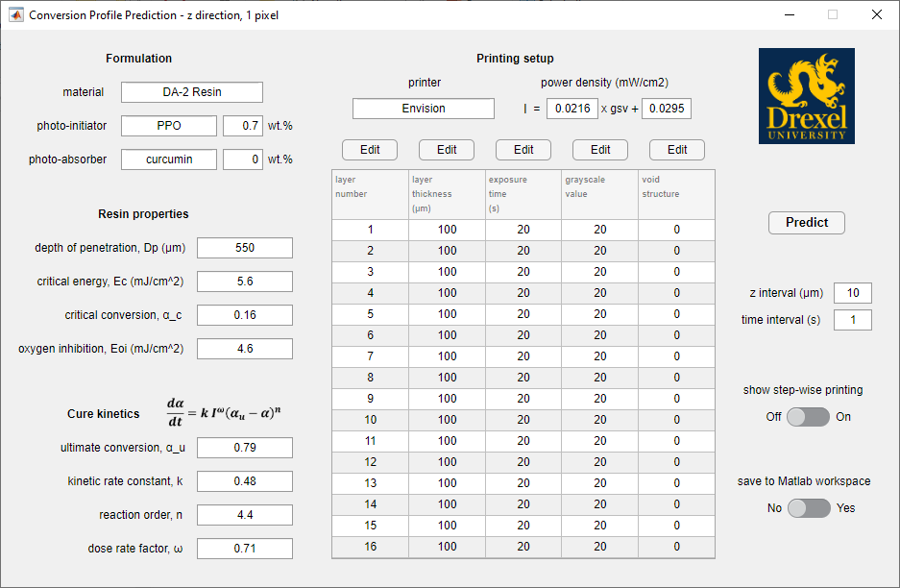
Conversion Profile Prediction Program
Information
Parameters
z interval
the z spacing between predicted data points
smaller z yields a finer prediction
time interval
time step between calculations
this feature is yet to be incorporated
Toggle on to show
layer-by-layer
printing!

Slide 2
Instruction to use the program
Please follow the following steps to use the program:
If you have the previous version of the program, delete it.
Follow the link to download the “DLP model” folder to your Matlab folder.
Open the Matlab software, then in the “Current Folder” window, navigate to your Matlab folder.
Right-click on the “DLP model” folder in the “Current Folder” window, and Add to Path – Selected Folders and Subfolders.
Now the program is ready; for convenience of future use, save the path by clicking on the “Set Path” icon and then “Save”, so next time you open Matlab, you can start from Step 6.
In the Command Window, type dlpmodel, and hit enter, a GUI as shown in the previous slide will appear.
Modify the parameters as you need. The default values are for DA-2 resin with 0.7% PPO as the photo-initiator and no photo-absorber. The default printer is the Envision.
To modify the printing parameters in the table, double-click on a cell to change the value for the cell; if you need to modify the values for the whole column, click on the “Edit” button on top of the column.
If the “show step-wise printing” is turned on, the program will show the printing process layer by layer!
If the “save to matlab workspace” is switched to “Yes”, an input window will appear after the prediction requesting a name for the prediction. The result will be saved as an variable in the ”Workspace” window, and double-click on the variable will show the details of the result in the “Variables” window; note that the result is not saved to your hard drive,
If you wish to save your results to your hard drive, right-click on the results in the ”Workspace”, and save the variables to a location of your choice.

Slide 3
Explanation of “Void Structure”
All the other parameters are fairly straightforward
The parameter “void structure” is explained here:
0 stands for an open structure
1 stands for a closed structure
new resin
in an open pixel, non-gelled resin is able to flow out, and be replaced with new resin when the platform displaces
open
platform
displaces
layer
thickness
exposure
liquid
gelled
in a closed pixel, non-gelled resin is not able to flow out, and stays in the pixel space when the platform displaces, therefore the exposure history is retained.
1 pixel
conversion profile
closed
btw, I am not sure if “void structure” is an accurate description. If you have a better idea, please let me know.

Slide 4
Application I: Flattening Conversion Profiles
The model predicts that, for printing 32 layers of DA-2, if the exposure time of the last layer is set to 9 times the normal exposure time, the conversion profile will be flattened.

Slide 5
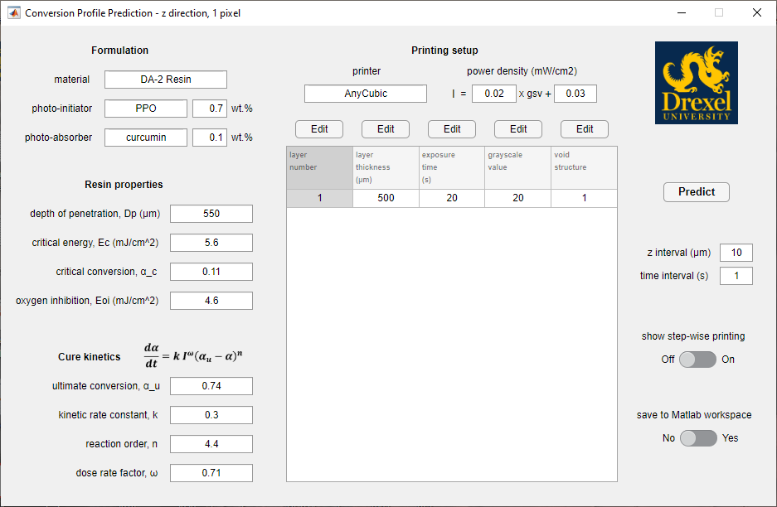
Application II: Critical Conversion Estimation
A working curve experiment

Slide 6
Critical Conversion Estimation
Compare calculated working curves based on different α_{c}s with the experimental one
calculated based
on 25 ºC kinetics
calculated based
on 35 ºC kinetics
The predicted working curve based on 35 ºC kinetics with α_{c} = 0.16 matched the low dose end of the experimental curve and the predicted working curve based on 25 ºC kinetics with α_{c} = 0.16 matched the high dose end better.
Explanation: reaction rate is faster at low depth because of stronger light intensity, which induces temperature rise.
It can be concluded α_{c} ~ 0.16.

Slide 7
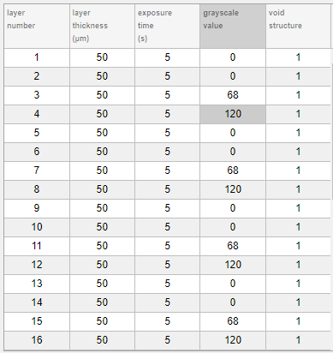
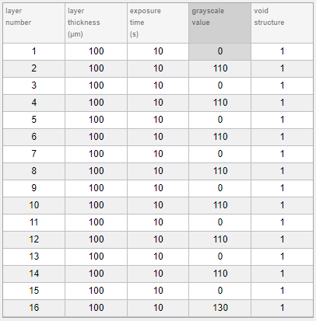
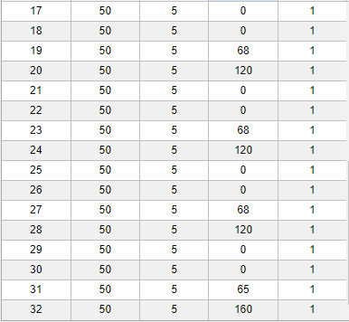
Application III: Printing Materials with 2 Phases
DA-2 resin with 0.1% curcumin as photo-absorber has a D_{p} of ~65 μm

Slide 8
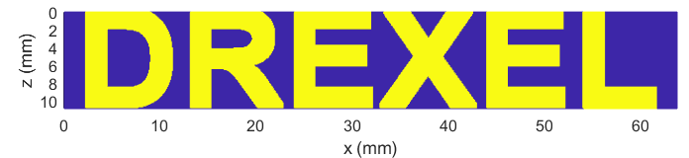
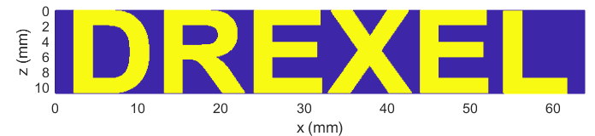
Application IV: Improving Printed Part Fidelity
Uncorrected DLP printing, predicted
STL model
Predicted grayscale printing with adjusted parameters
Compare the horizontal bars, and round corners.
Precision with the grayscale printing is higher.

Slide 9
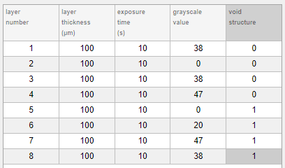
Application V: Predicting and Monitoring the Printing Process
When the “show step-wise printing” is turned on, the program will show the printing process layer by layer.
The example below shows the printing of DA-2 resin, using the default resin properties and cure kinetics, and the printing parameters given in the table.
It starts with an empty graph, indicating the printer is initialized and printing is about to start, and proceeds to the prediction of the printing of the many layers, as shown in next slide.

Slide 10
Printing Prediction
The lines in each layer show the changes of conversion profile with printing progression.
The solid line is current.
The second layer showed some discontinuity in conversion at the top of the layer.
This is because the grayscale value of the third layer is slightly low.
If the grayscale of the third layer is set to 39 or 40, that discontinuity can be eliminated.

